Slide 1
Summary & Quiz
Week 1, Day 5

Slide 2
Today’s lesson
Summary of Week 1 Lectures(Day1~4)
Quiz !
13 questions.
Will count towards your final grade.
Listen to the summary lecture well-- many parts of the quiz will be covered!
Special Lab

Slide 3
Previously...
What is a program?
What is an algorithm?
Computational Thinking
Python
Functions
Bugs

Slide 4
Previously…
Classes
Hubo
Objects & Data Types
Control flow

Slide 5
Program & Algorithm-2 questions
Program
An exact set of instructions for the computer to follow.
Algorithm
An exact set of instructions given to the computer to solve a problem.
Programming languages
Python, C, C++, Java

Slide 6
Functions – 1 question
Functions are blocks of organized , reusable code.

Slide 7
More about functions
Structure of a Function

Slide 8
More about functions
Starting a definition:
def + function name
Structure of a Function

Slide 9
More about functions
Starting a definition:
def + function name
Structure of a Function
Function’s parameters

Slide 10
More about functions
Starting a definition:
def + function name
Structure of a Function
Function’s parameters
Statements

Slide 11
More about functions
Starting a definition:
def + function name
Structure of a Function
Function’s parameters
Statements
Return value

Slide 12
More about functions
Starting a definition:
def + function name
Structure of a Function
Function’s parameters
Statements
Return value
*A function doesn’t always need a return value.
*A function doesn’t always need parameters.

Slide 13
Bugs-1 question
Syntax- problems in writing
Run-time- problems while running
Semantic- problems in algorithm/solution

Slide 14
Bugs-1 question
Syntax- problems in writing
Run-time- problems while running
Semantic- problems in algorithm/solution
What’s wrong here? What bug is it?
For i in range(3)
printf(“hello students!”)

Slide 15
Objects & Data types- 2 questions
What are objects?
Every piece of data in Python is an object.
Every object has a type
Object/Data types
Numbers
Strings
Booleans
Self-defined objects- classes(e.g hubo)
How do we create an instance of a hubo object?
hubo = Robot(beepers = 5)

Slide 16
Variables and naming objects- 1 question
Naming objects(variables)
No def, if, else, while, True, False.
Only Letters, digits, underscores(_).
First character should not be a digit.
Case-sensitive.
Examples
more@ = “ok or not”
3hello = “hello”

Slide 17
Boolean expressions- 2 questions
Evaluating Boolean Expressions
Examples:
3<5
27 == 14

Slide 18
Conditionals - 1 question
if(it rains):
Hubo.study
elif(it snows):
Hubo.sleep
elif(it is windy):
Hubo.watch_tv
else:
hubo.dance
if(it rains):
hubo.study
else:
hubo.dance

Slide 19
Loops- 2 questions
For-loops
While-loops
for i in range(5):
print(“I love this class!”)
while hubo.front_is_clear():
hubo.move_and_pick()

Slide 20
Additional Tips- Operators
Sum = Sum + 1
Sum += 1
This works for all operators.
Sum = Sum * 2
Sum *= 2

Slide 21
Additional Tips- Strings
We can concatenate strings through +

Slide 22
Additional Tips- Strings
We can concatenate strings through +
“Hello” + “Students” → “HelloStudents”

Slide 23
Additional Tips- Strings
We can concatenate strings through +
“Hello” + “Students” → “HelloStudents”
“Hello” + “ “ + “Students” -> “Hello Students”

Slide 24
Additional Tips- Strings
We can concatenate strings through +
“Hello” + “Students” → “HelloStudents”
“Hello” + “ “ + “Students” -> “Hello Students”
“Hello “ + “Students” -- > “Hello Students”

Slide 25
Additional Tips- Strings
We can concatenate strings through +
“Hello” + “Students” → “HelloStudents”
“Hello” + “ “ + “Students” -> “Hello Students”
“Hello “ + “Students” -- > “Hello Students”
“Hello “ + “” + “Students” → “Hello Students”

Slide 26
Quiz Time
13 questions

Slide 27
Special Lab

Slide 28
First finish tasks from yesterday!

Slide 29
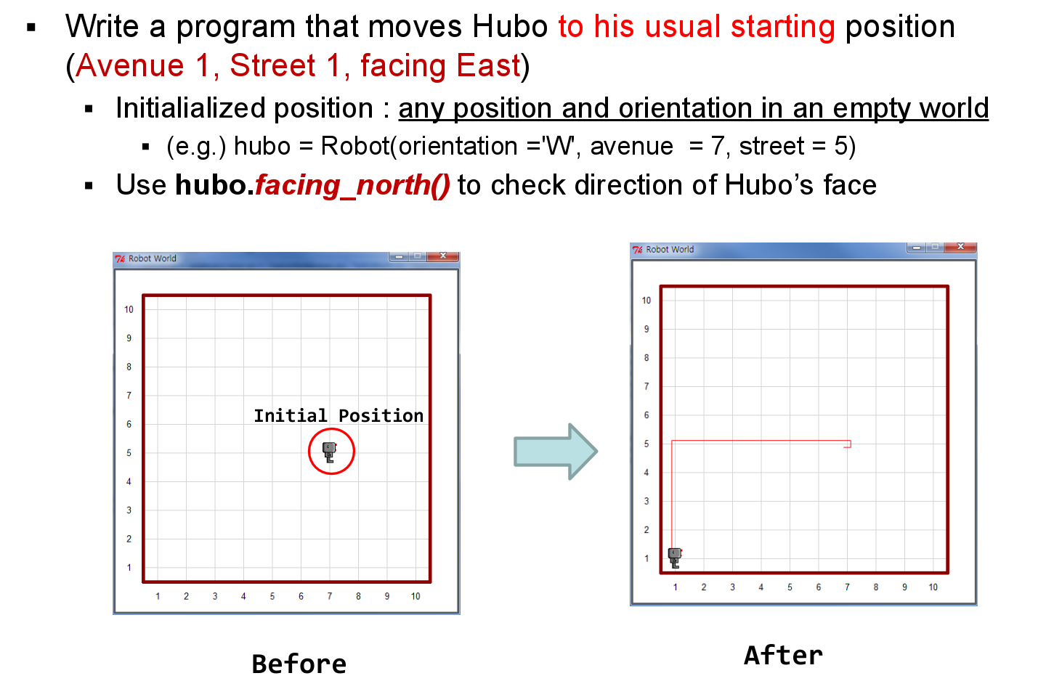
Extra lab 1

Slide 30
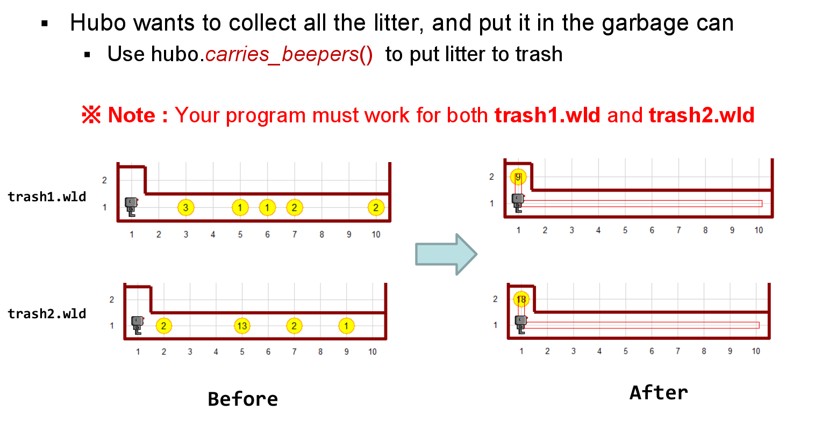
Extra lab 2

Slide 31
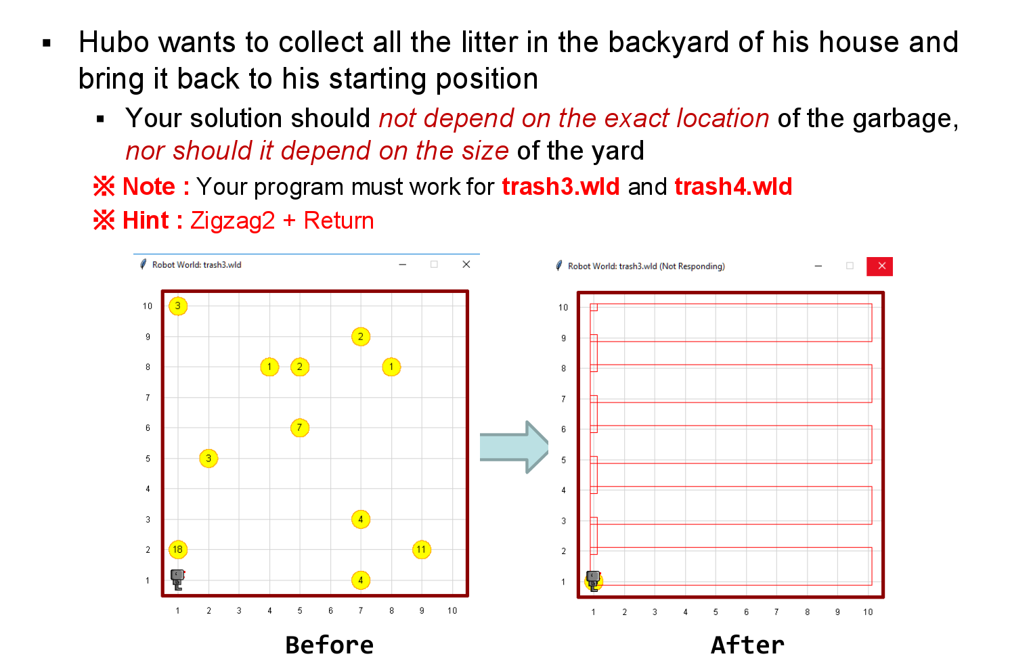
Extra lab 3

Slide 32
Extra lab 4
Hubo maze!
Talk to the Tas!

Slide 33
Good luck!

